Slide 1
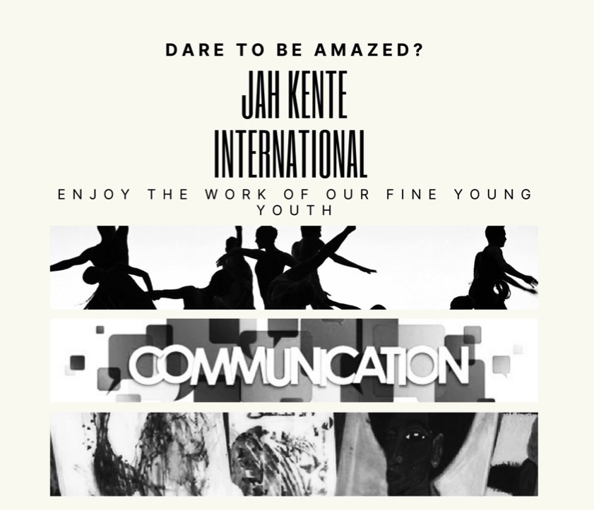
VISUAL ART &FASHION

Slide 2

Jah Kente International-Marion Barry Summer Youth Employment Program 2021.
Jah Kente International ® is a Registered Trademark.

Slide 3
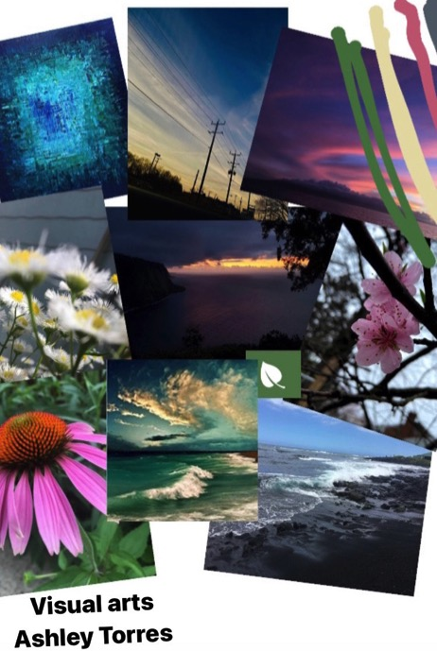
Ashley Torres
Visual Arts
MOOD BOARD:
This mood board represents all that I use visual for. I take landscape, nature, photos to show the beauty within. The words essence, life, and balance all tie with nature and the effects it has on us. Colors from green, blue and pink are what I usually deal with.

Slide 4
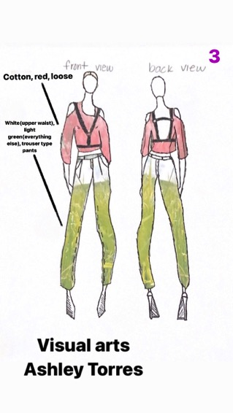
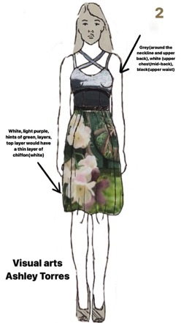
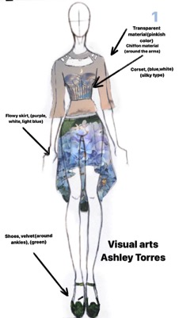
FASHION DESIGNS EXPLANATIONS:
My piece is called one with nature. People often don’t tend to care about what happens with nature like pollution which affects the beauty of it.
First design:
From top to bottom, the sky represents the top, flowers the skirt, shoes the grass and the corset is the sky as well. The shoes were a symbol of always keeping your feet stable and knowing that where you stand today can be gone tomorrow. The corset was a way to show that there are some restrictions that limit nature’s beauty. The blouse was a chiffon type material to show hidden beauty.
2nd piece:
I wanted something more tidy but fashionable. The added layer of chiffon into the skirt would be carried into this piece as well with it being a hunted message to pollution.
3rd design:
This design is more of a casual piece. It represent nature affects everyone. It brings people both stability and calmness. The harness represents bringing that anger and other emotions in and letting the positive ones come through.

Slide 5
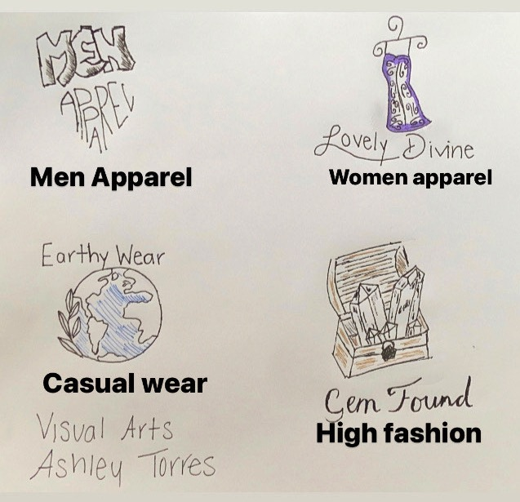
LOGO EXPLANATION:
For men apparel, I wanted something that was going to bring in males. It would be a store where it has both suits and blazers along with some trousers and street wear in a sense.
Women apparel would be dresses that are high end and low end. For people on a budget or people wanting to go all out for prom. Ranges from train dresses to maxi dresses.
Casual wear was more of a laid back logo. It’s supposed to represent more down to eating vibes. Prominent colors like brown, light green, water and light blue would be in the store. Clothes like cardigans, flannels, trousers, hats, earrings, and silver bracelets.
For high fashion, I wanted a design that is memorable. The original name was going to be “Gem in a Box” but I felt as though it was too giving too much information because the logo is just that. So I decided to go with “Gem Found.” It would be dresses that are one of a kind and customizable.

Slide 6
So my inspiration for this piece was mostly the words itself. I didn’t want anything too distracting because the words were already bringing people in. The two parts of the bottom part of the dress are different colors representing different people in different classes like middle or rich and how culture brings us all together. The attachment is the new design. I made the outline, the black part, a bit grey so it wouldn’t be too harsh on the eyes.

Slide 7
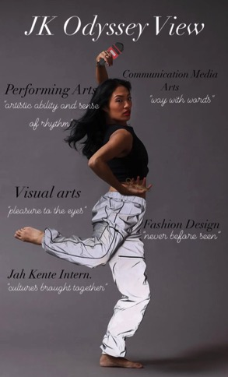
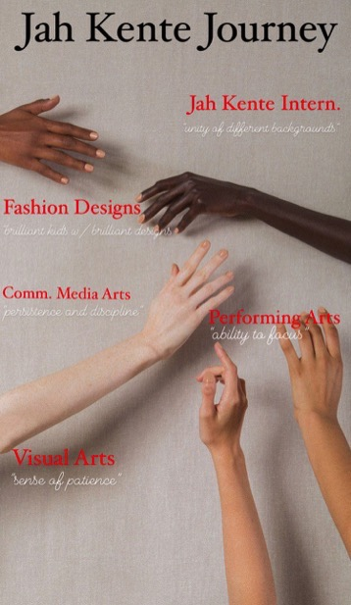
MAGAZINE COVER
DESIGN IDEAS
JK Odyssey View, I was thinking of incorporating all the workforce’s in one picture. A performing artists, preferably a dancer, would do a pose of their choice wearing a design from a fashion designer who the workforce would choose. The scissors in the models hand represents fashion designers. The mic on the upper hand represents both singers in the performing arts workforce and communication media arts. I made up the name “JK Odyssey View” because odyssey means a long journey with different obstacles which is what every kid in the program goes through.
Jah Kente Journey, I was thinking of how Jah Kente has different people from different backgrounds. So, I found a picture online and it was perfect. It stood for everything Jah Kente is. The name can be changed to what we choose.

Slide 8
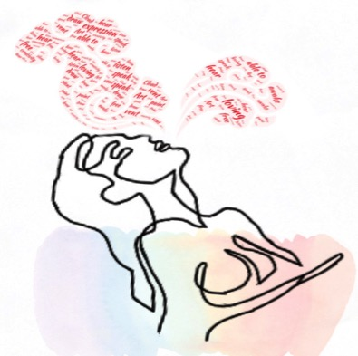
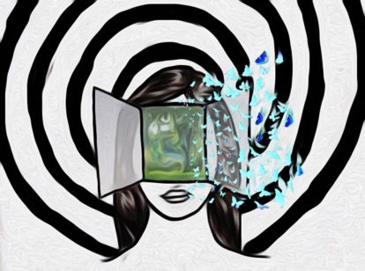
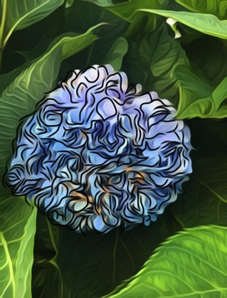
Spiral-
“Formation or Elegance”
This piece was inspired by my transformation throughout this program. In the beginning I was introduced to new things. As I got into fashion and visual arts, I realized I could easily be able to express myself in something other than words and my art would represent me and who I am as a person.
Red word art cloud-
“Energy of Expression Constructed”
This piece was about how I was able to find a voice in this program with Jah Kente. The different words interpreted mean I am able to be free from restraints and be able to express myself with art. With the words “loving” and “able to” which represent the love of art.
Flower-
“Still life w/happy continuation”
Inspiration for this art would be I wanted a picture of my photography in it. So, I decided to turn the photography into somewhat of an abstract art and outline it. The significance would be that it’s okay to paint outside the lines because it might lead to something that can change your life.

Slide 9
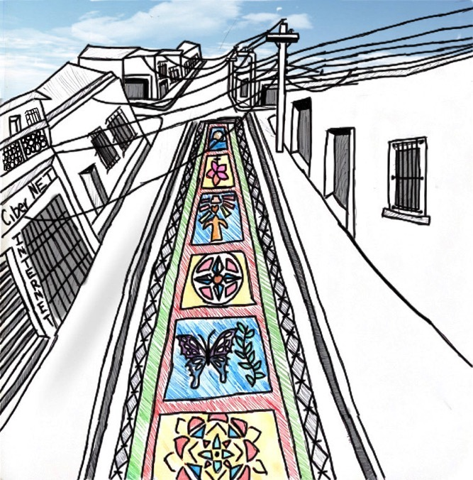
“Semana Santa”
The title of this piece means Holy Week which is the week before Easter.
Since Jah Kente is all about culture, I wanted to bring some of my culture into the magazine too. This is how Semana Santa would look like. People bring in alfombras which is like carpet material and lay them in the streets. They then bring stencils and colored sawdust to create the designs on the alfombras. They are usually all along the streets and the streets would be closed. Bringing in my culture to the magazine would give the magazine a look into what my life is like and what made me who I am today.

Slide 10
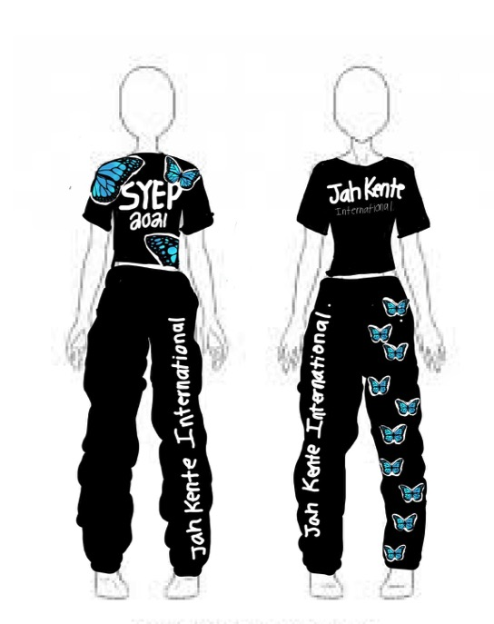
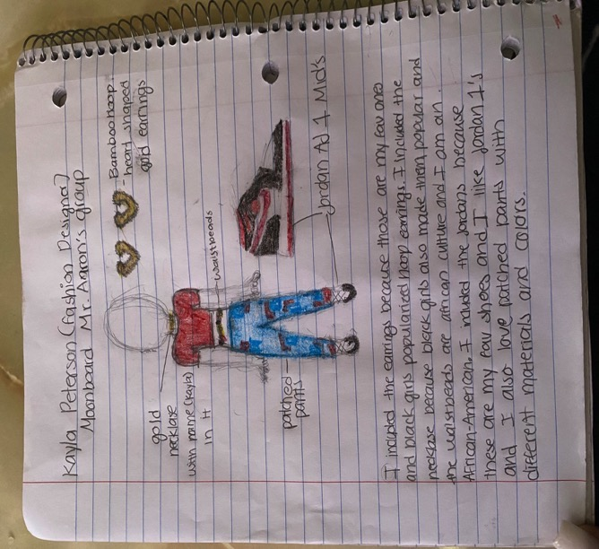
KAYLA PETERSEN
Fashion Design

Slide 11
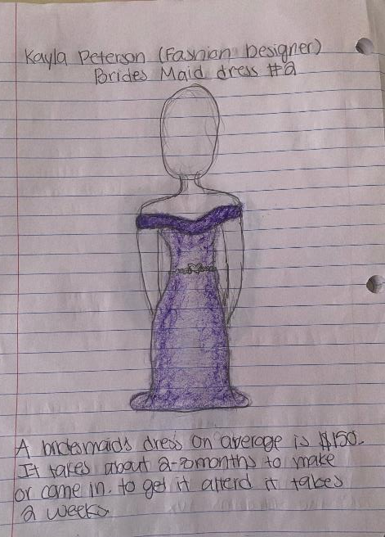
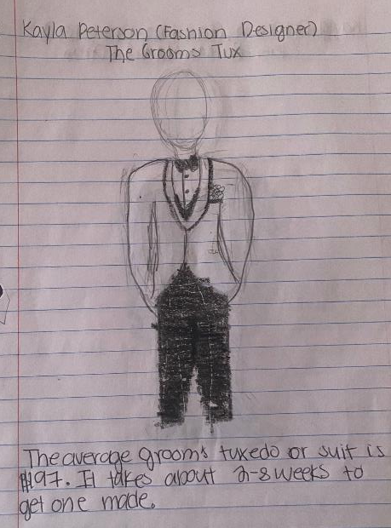

Slide 12
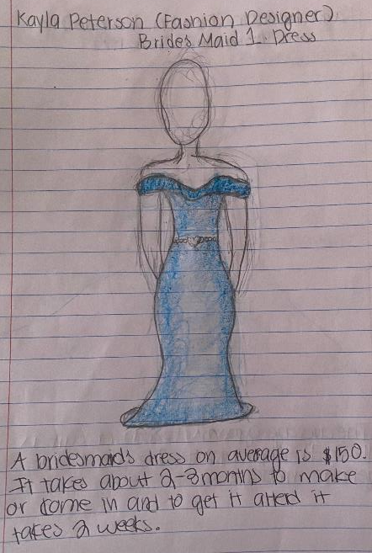
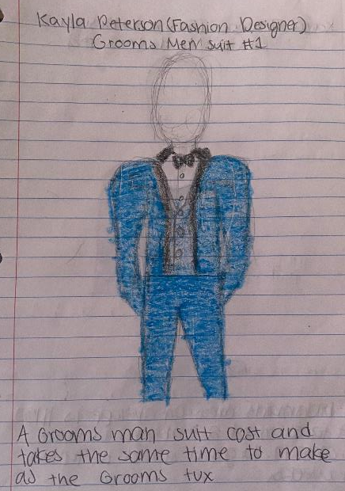

Slide 13
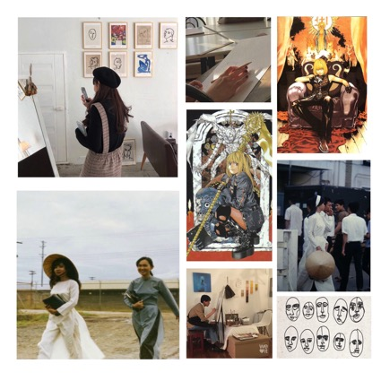
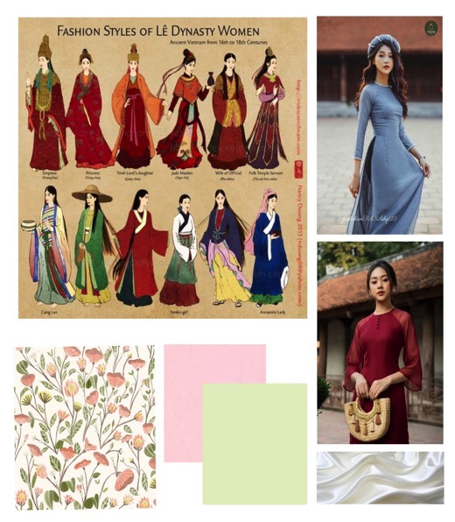
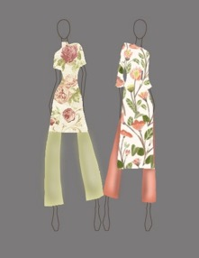
LISA LI
Visual Arts

Slide 14
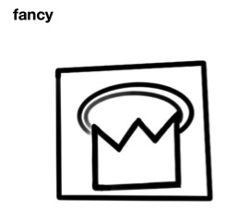
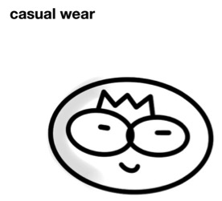
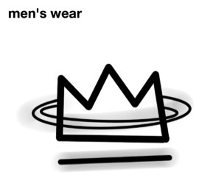
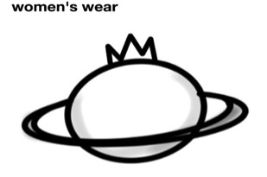
Mood Board:
I'm an artist that uses pencils and sometimes digital. I like anime and manga so I wanted to add some manga covers that inspire me to dress a certain way. I'm Vietnamese so I wanted to add some pictures of Vietnamese women from the past (Early 2000's to 80's, I'm not sure.)
Again, I'm Vietnamese so I wanted to make simple designs for Ao Dai. I always like floral patterns and the color palettes really suit each other.
For the logos, this was my first time making them so I wanted to do something simple and fun. All the logos have crowns because I think everyone is fit for a crown and are royalty no matter where they come from. It's not my best work, but I wanted to give it a try.

Slide 15
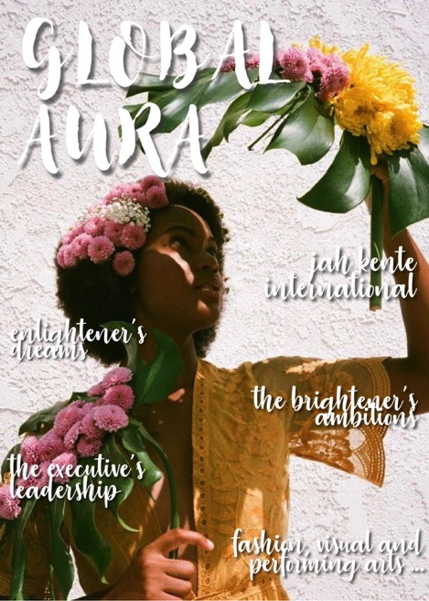
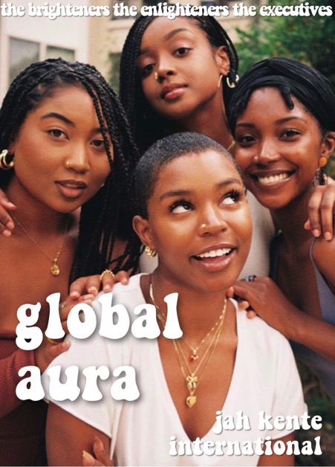
MAGAZINE DESIGN

Slide 16
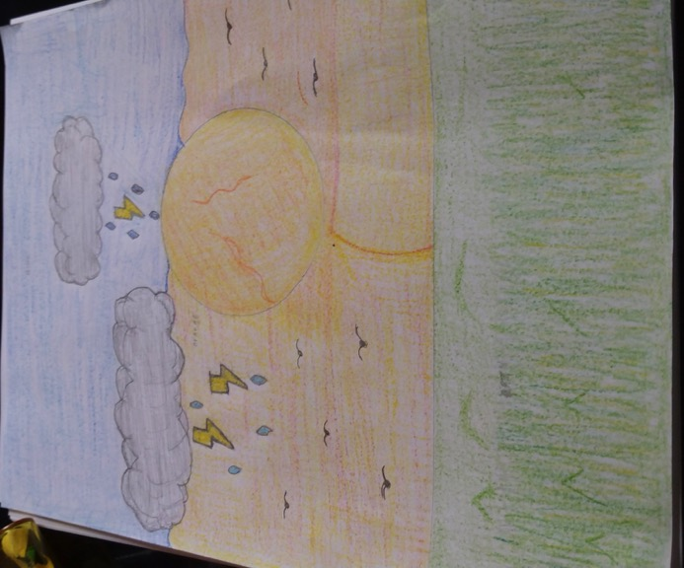
STANLEY GRIFFIN
Visual Art
&
Fashion

Slide 17
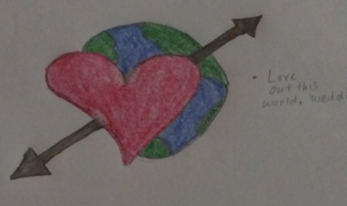
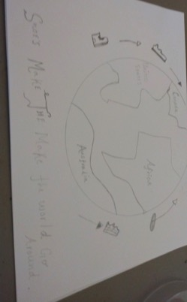
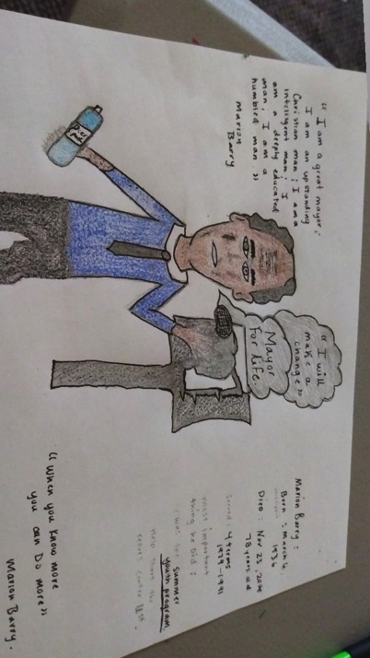
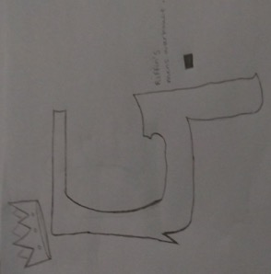

Slide 18
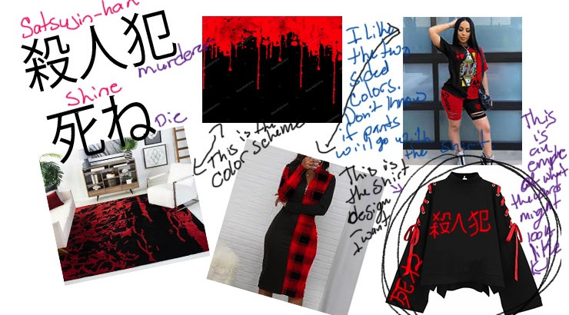
MIA BROWN
Visual Arts

Slide 19
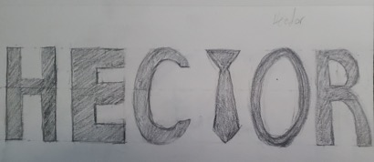
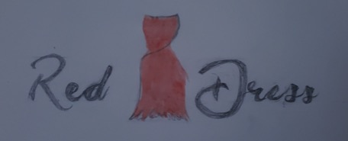
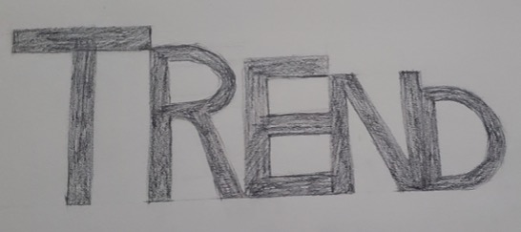
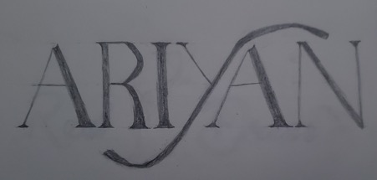

Slide 20
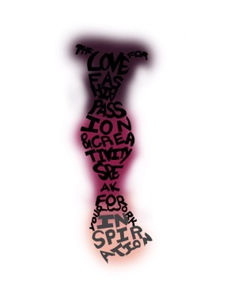
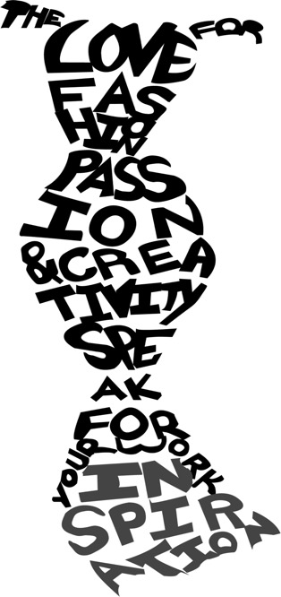
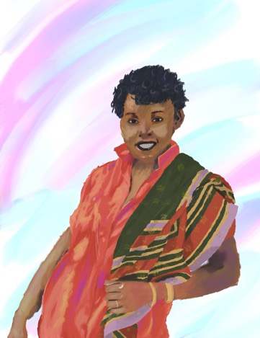

Slide 21
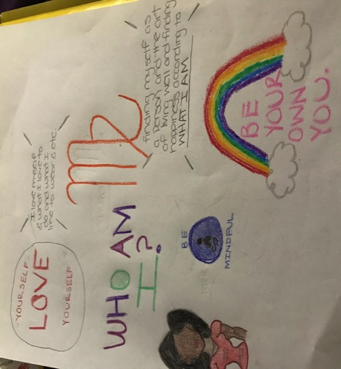
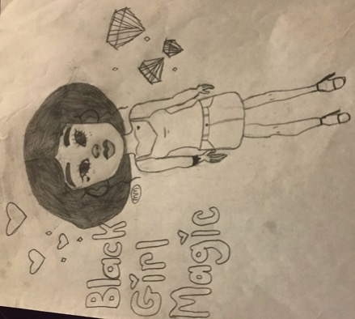
UNIQUE JACKSON
Fashion Design

Slide 22
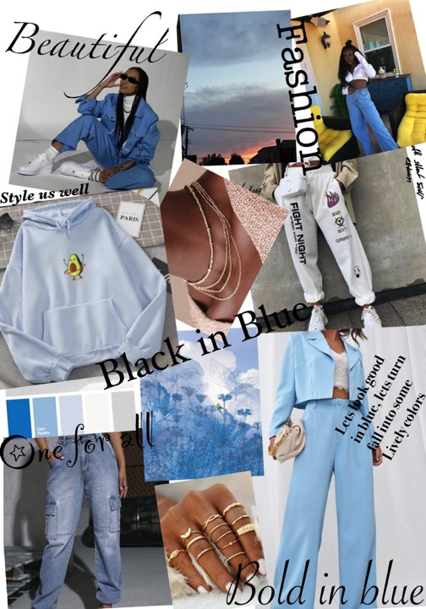
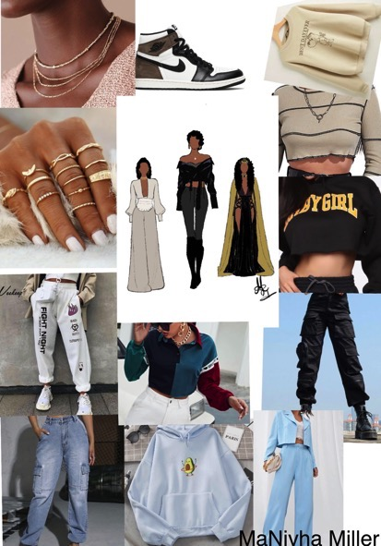
MANIYHA MILLER
V
I
S
UA
L
A
R
T

Slide 23
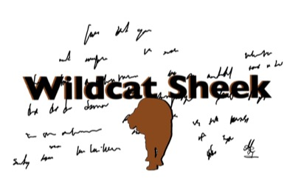
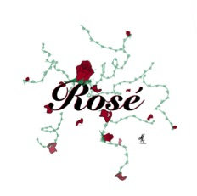
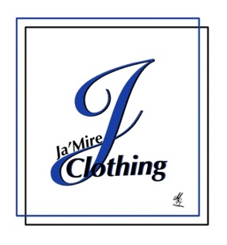
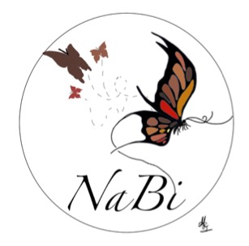
LOGO DESIGNS

Slide 24
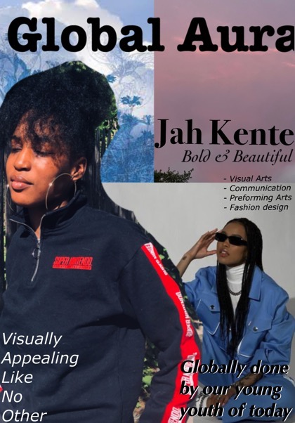
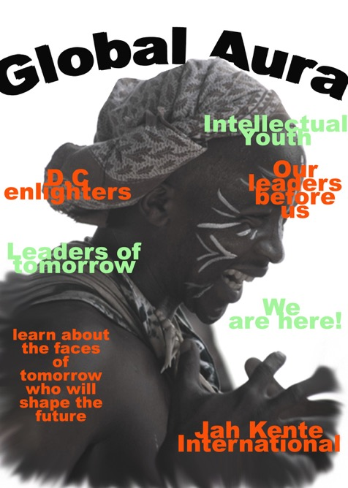

Slide 25

I’m going to try to explain this as best as I can, my thought process behind designing this piece is how I view myself in my artwork that I create. The words that you see are words that I tell myself and that I have heard from other people that can be negative about the different pieces I have created. Behind the screen are also some of the artworks that I have drawn that I normally don’t show to other people or if I do it will be seen once and never to be seen again. So the four women that you see are all women that I have created to represent a different version of myself that I want to be seen, where as I want to look sophisticated and if I go out I want to look sexy and appealing or if I just want to be how I normally dress in all black and cozy.
Also the lines that you are seeing are to represent cracks that shows myself falling apart through my art work where I feel that I am not good enough as I should be. The version of myself that stands front and center in all orange shows represents how I keep myself locked up from showing my true potential or allowing my work to be viewed by all. I can’t blame anyone for me not blossoming but myself.
Which is why you see a hand (my hand) that shows me drawing everything that you see but also shows that everything you see what I want you to see (meaning myself)

Slide 26



Slide 27



Jailynn Brown fashion

Slide 28



Slide 29


Slide 30



Slide 31






Zahi Covington visual Art

Slide 32



Slide 33




E’TOVA
Logo designs
1. fashion- the name for this one is gothic fashion Pandora Box
2. casual- the name for this look is named Ugly Duckling.
3. Women's clothing, Lady in red.
4. men's clothing Sk8er Boi

Slide 34








Slide 35





Slide 36






Slide 37




Slide 38




Tyetiana Ford fashion

Slide 39


Samara Winston visual arts

Slide 40






Slide 41




Yaphet Negussie

Slide 42






Slide 43





Slide 44



INSTRUCTOR
MR AARON HARRIS
OWNER AND FOUNDER OF

Slide 45



Slide 46




Slide 47






